Slide 1
Exotic food culture (異國美食文化報告)
Japanese food culture
劉家齊32
張詠翔19

Slide 2
Why choose Japanese food culture?
Like to eat romen
Find it very interesting
Worth learning

Slide 3
Japanese dining etiquette:
1Shares tableware
2Chopsticks usage
3Talk before and after meals
4Desk code

Slide 4
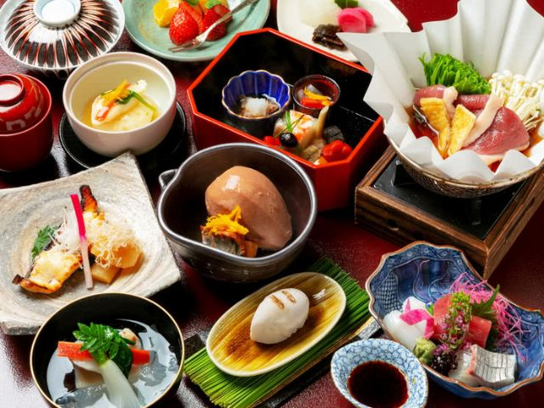
1Shared tableware
Everyone has a meal,you should
use the other end of the chopsticks
or use public chopsticks

Slide 5


2Chopsticks usage
Don't poke food with chopsticks
To get the end of the chopsticks
Don't use chopsticks to move plates or bowls
Don't insert chopstucks into the bowl
Don’t use your own chopsticks to pass food directly to another person's chopsticks

Slide 6
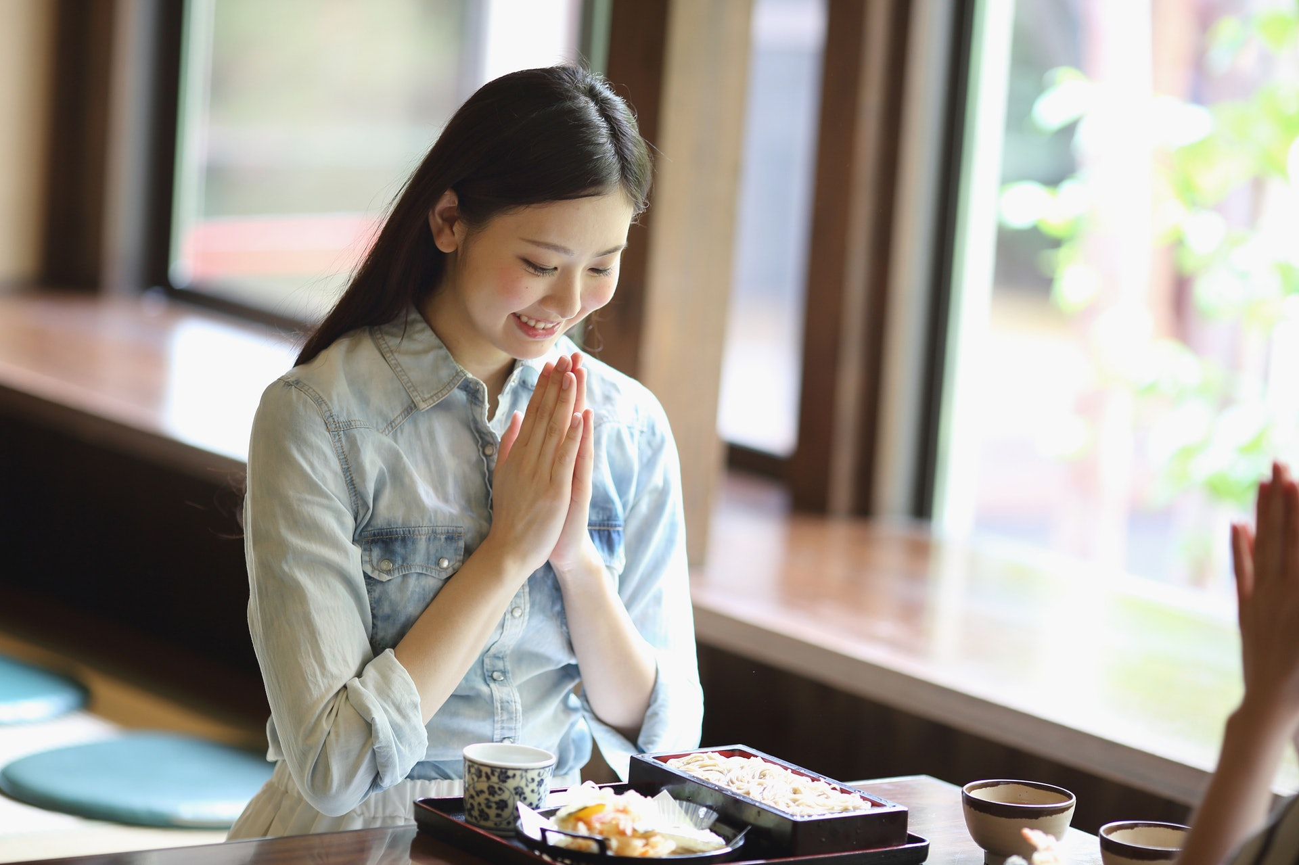
3Talk before and after meals
Itadakimasu
Gochisousama

Slide 7
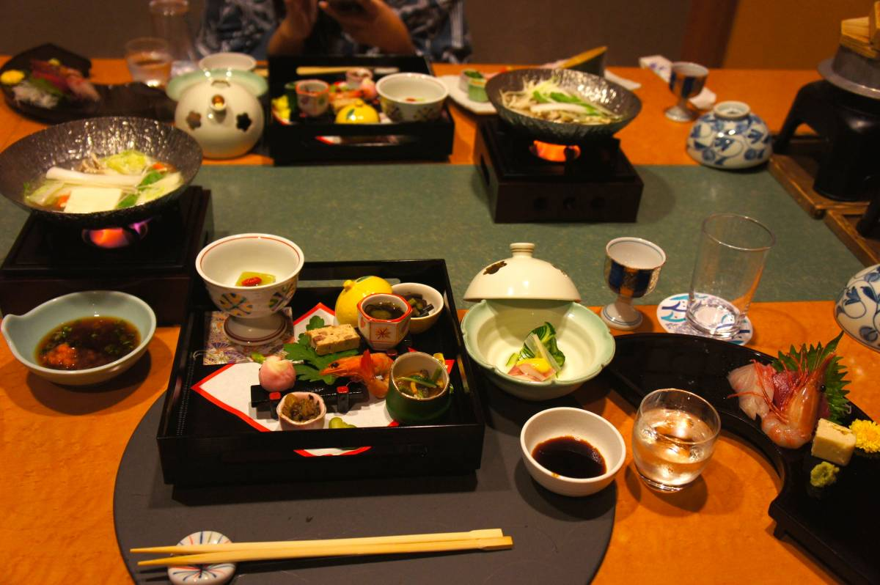
4Desk rules
Do not blow your nose in public
No hiccups
Don't talk about the appetites before or
during the meal
Going to meal ordea completely eaten
After eating,put the utensils back in place

Slide 8
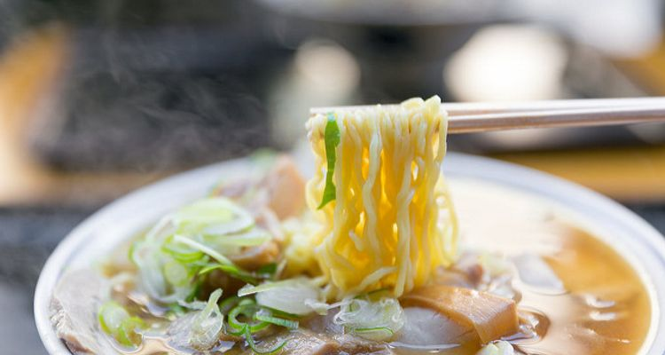
The cultural of ramen:

Slide 9
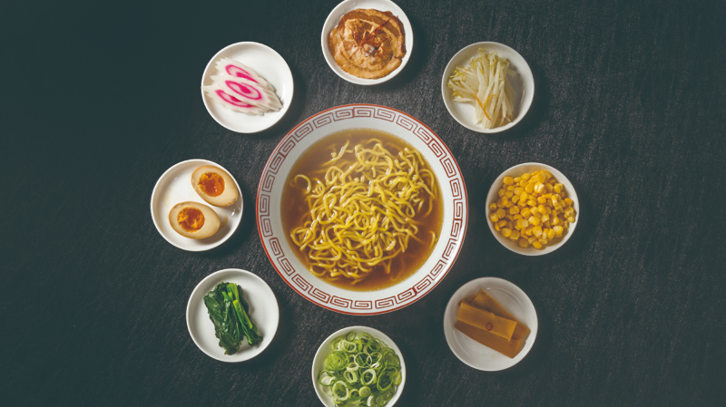
Three points of ramen:
Soup
noodles
Ingredients

Slide 10
Soup:
1.ramen’s soul
2. Two species:Pork/Chicken bone soup
Flavor :
pork bone soup is more rich
Chicken bone soup is morelight

Slide 11
Noodles:
1.
Orthodox ramen is not used for ramen,
but knead flour into dough and cut into thin strips
2. Each ramen shop will have its own recipe for noodle
making, with unique ingredients added the taste of
noodles and the function of increasing toughness

Slide 12
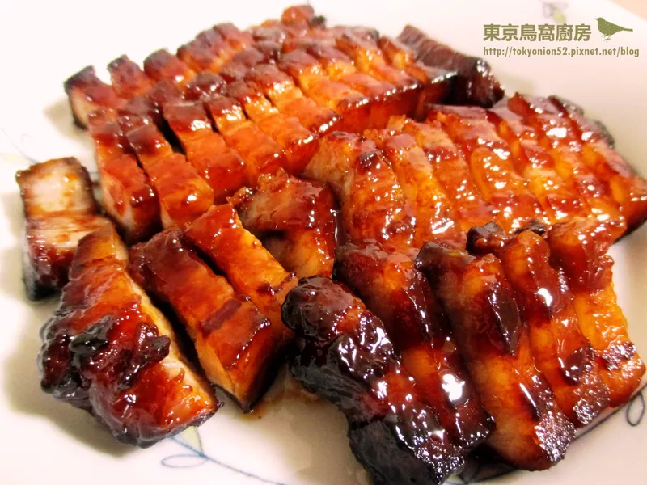
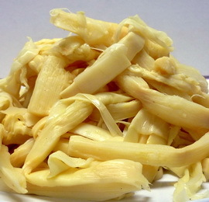
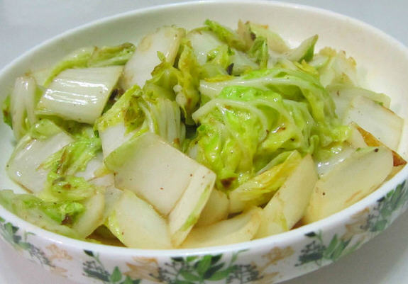
Ingredients:
Basted
(叉燒)
Bamboo shoots
(筍乾)
Vegetable

Slide 13
Ramen Features Around Japan:
North、Middle、South

Slide 14
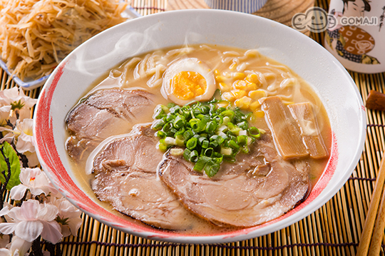
North:
Miso ramen

Slide 15
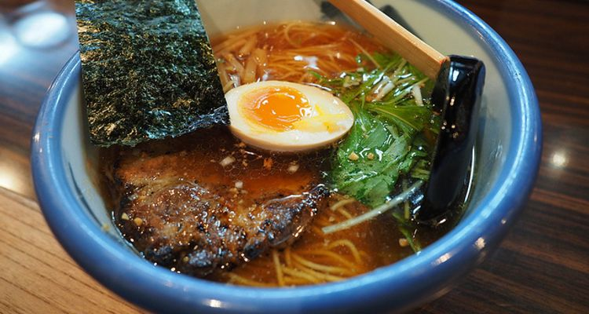
Middle:
Tokyo normal oil ramen

Slide 16
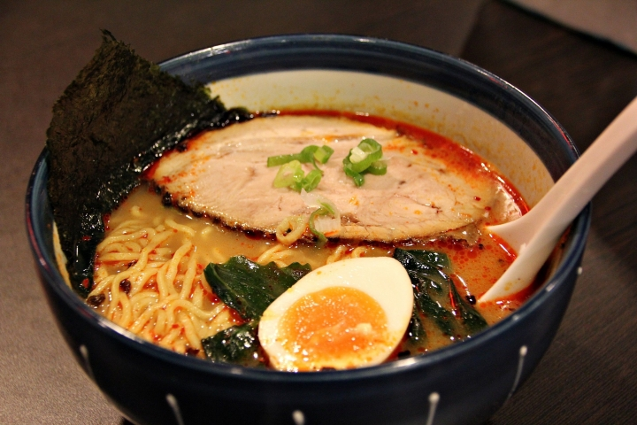
South:
Spicy ramen

Slide 17
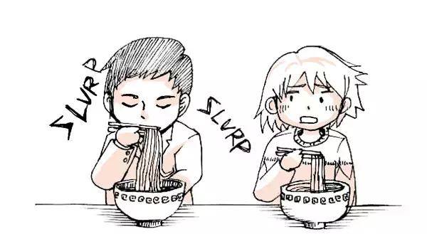
Differences in habits from Taiwan when eating
Noise

Slide 18
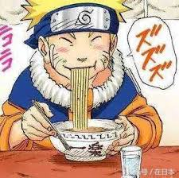
When Japanese eats ramen.it will make a「susu」noise
because of the represent of the ramen’s
delicious flavor
It comes to proof the response to ramen chef.
*Remember don’t make the noise deliberately
Because of some people don’t like the noise of 「susu」
and make them pissed off.

Slide 19

最後 結束

